Slide 1
Stimuli

Slide 2
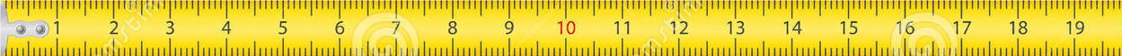

Slide 3


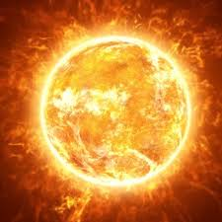


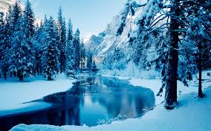
Instructions
In addition, the aliens’ planet goes through different seasons, and aliens will need different things depending on these seasons!
For example, one alien might need to swim in a mud puddle in the hot season, but it needs to sleep in a bed during the rainy season in order to grow.

Slide 4

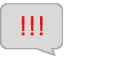
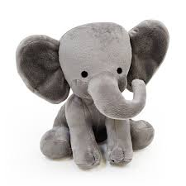
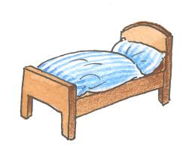
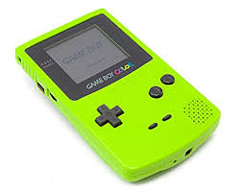

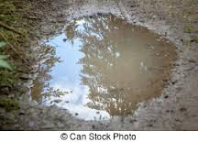
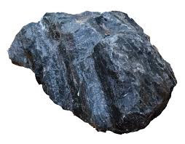

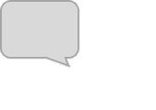
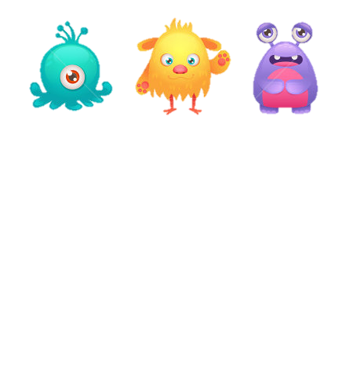

Slide 5

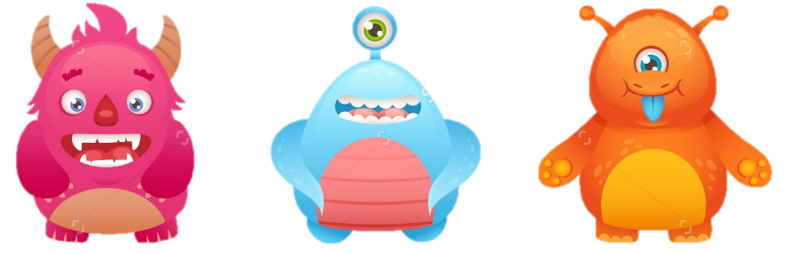

Slide 6



Slide 7


Slide 8
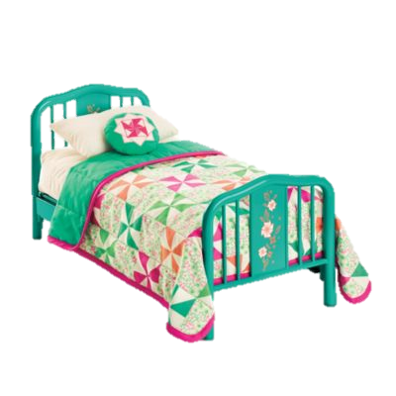
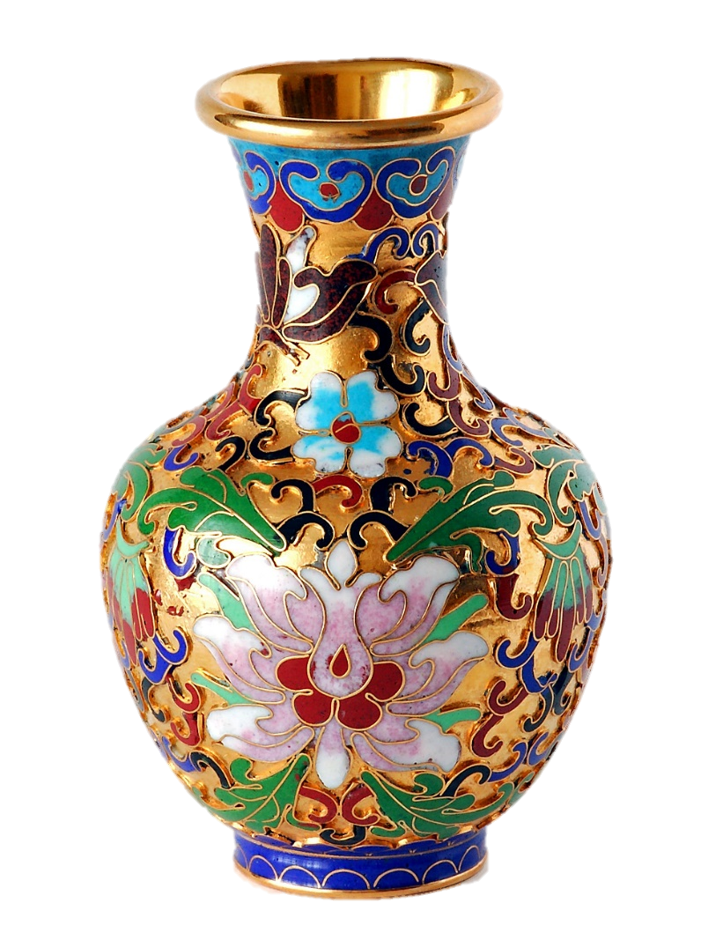

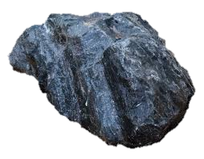
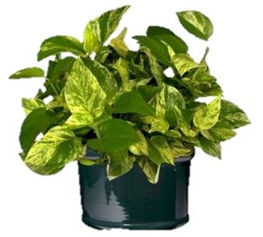
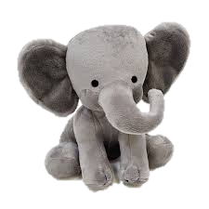

Slide 9
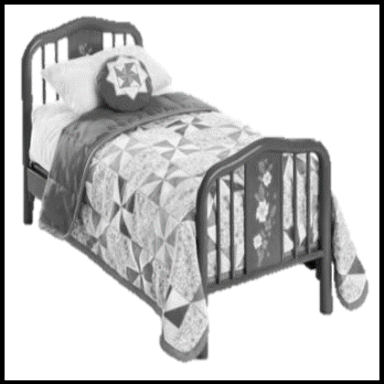

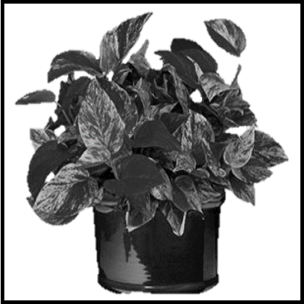
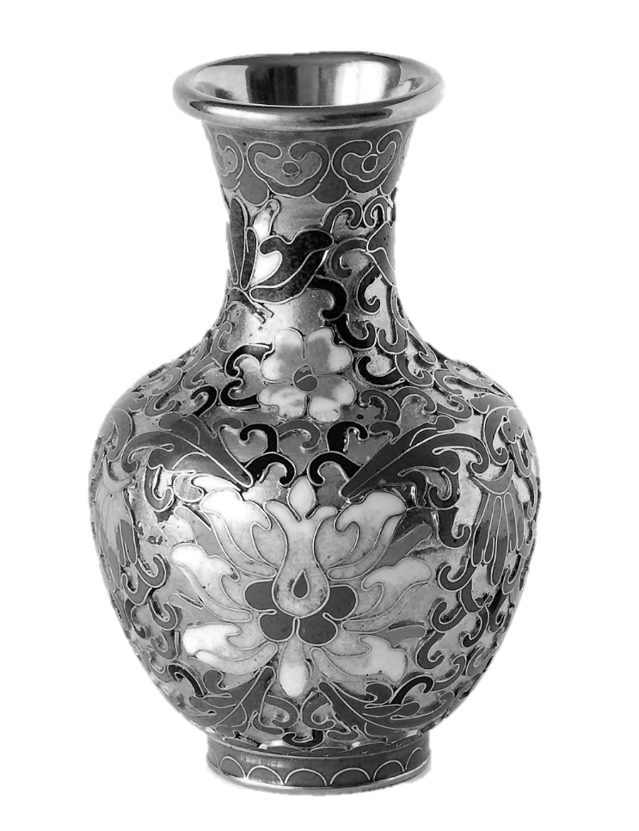

Slide 10



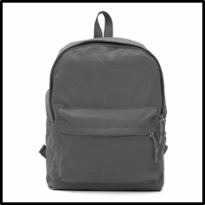



Initial learning phase
Correct response Incorrect response
Stimulus
Context
New season!!
…
Reward
Action
…
New season!!
Block 3 Block 2 Block 1
…
…
…

Slide 11
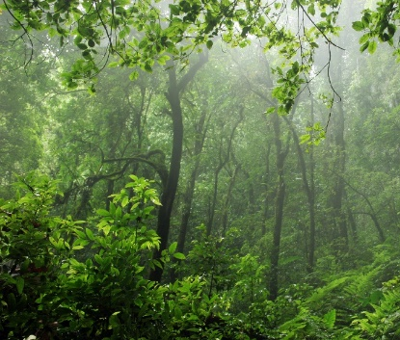
Context
Stimulus
Correct trial Incorrect trial
Action
Reward
…
Hot season Cold season
…

Slide 12






Testing phase “cloudy”
Testing phase “mixed”
Testing phase “competition”
Testing phase “mixed”
Which do you prefer?
Season switch
Alien switch

Slide 13















Mixed block
Comparison test
Novel context
Hidden context
Context and/or stimulus change in each trial
Action feedback
Test acquisition of TS
Indicate preferred context or stimulus
No feedback
Test acquisition of TS values
Novel context
No action feedback
Test acquisition of TS values
Hidden context
Action feedback
Test acquisition of TS and TS values
Context change
Stimulus change
Stimulus Context
New season!!

Slide 14






Hidden context
Comparison test
Novel context
Mixed test
Context hidden, context changes signaled
Action feedback
Test acquisition of TS and TS values
Assess preferred context or stimulus
No feedback
Test acquisition of TS values and stimulus values
Novel context
No feedback
Test acquisition of TS values
Context and stimulus can change in each trial
Action feedback
Test acquisition of TS
New season!!
Correct Incorrect
…
…
Stimulus Context
Context change
Stimulus change

Slide 15

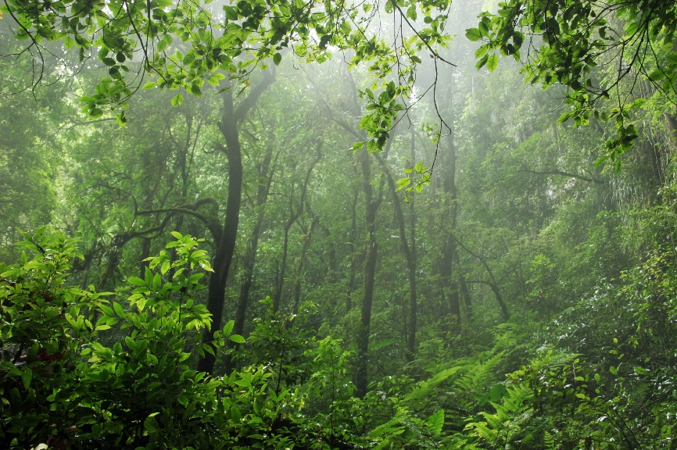




a
c
TS6
TS5
6 | 1 | 1 | 1
1 | 4 | 1 | 1
1 | 1 | 5 | 10
1 | 1 | 3 | 1
7 | 1 | 1 | 1
1 | 3 | 1 | 2
b
TS4
d
6 + 2 + 7 | 4 + 8 + 3 | 5 + 7 + 3 | 10 + 3 + 2
15 | 15 | 15 | 15
1 | 8 | 1 | 3
2 | 1 | 7 | 1
1 | 1 | 1 | 1
5 + 10 + 3 + 2 | 6 + 8 + 3 + 3 | 4 + 2 + 7 + 7
20 | 20 | 20

Slide 16



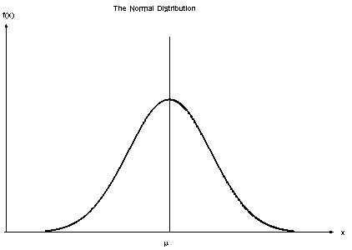
TS1
TS2
TS0
TS1
TS2
1
1
6 | 4 | 5 | 10
2 | 8 | 7 | 3
7 | 3 | 3 | 2
6.25
5
3.75

Slide 17
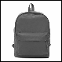
Context
Task set
Stimulus
Action
Reward
TS1
TS2
TS3
7 | 3 | 3 | 2
2 | 8 | 7 | 3
6 | 4 | 5 | 10
3.75
5
6.25

Slide 18
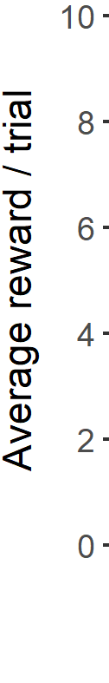
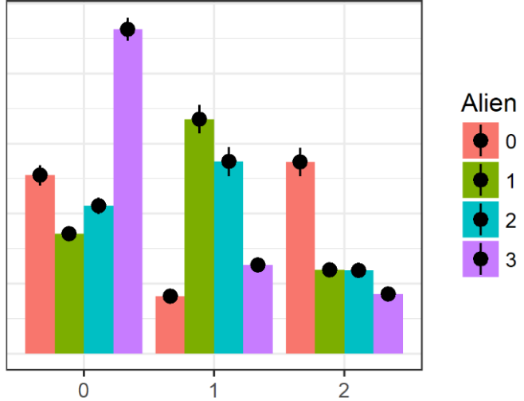
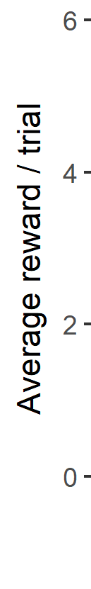
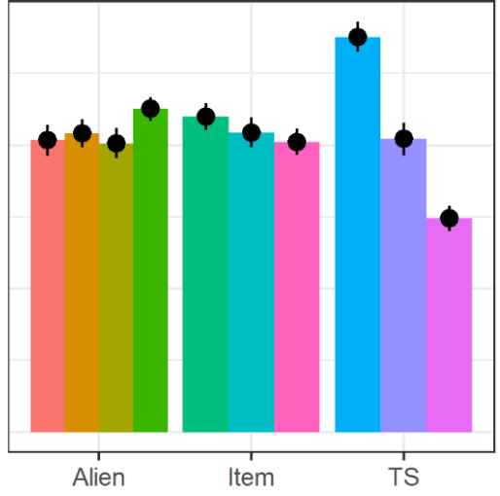
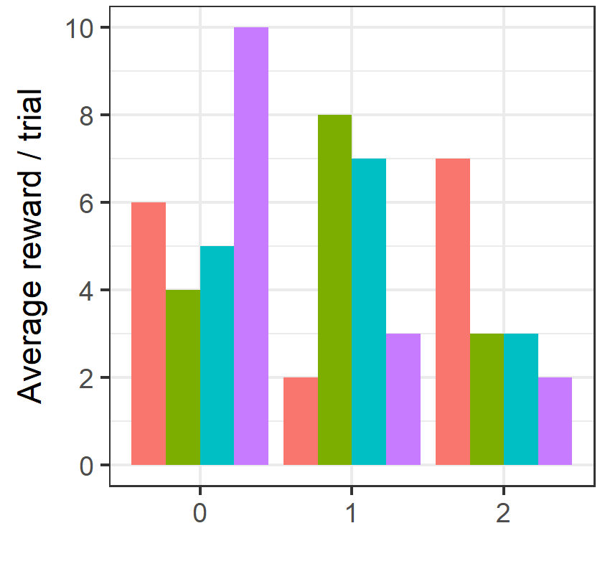
A
B
Average reward / trial
TS0
TS1
TS2
…
TS0
TS1
TS2
…
…
…
…
Average reward / trial
6 | 4 | 5 | 10
2 | 8 | 7
6.25
5
3.75
Aliens
Items
TS

Slide 19
TS1
TS2
TS0
TS1
TS2
6 | 1 | 1 | 1
1 | 4 | 1 | 1
1 | 1 | 5 | 10
1 | 8 | 1 | 3
2 | 1 | 7 | 1
1 | 1 | 1 | 1
1 | 1 | 3 | 1
7 | 1 | 1 | 1
1 | 3 | 1 | 2
6.25
5
3.75

Slide 20
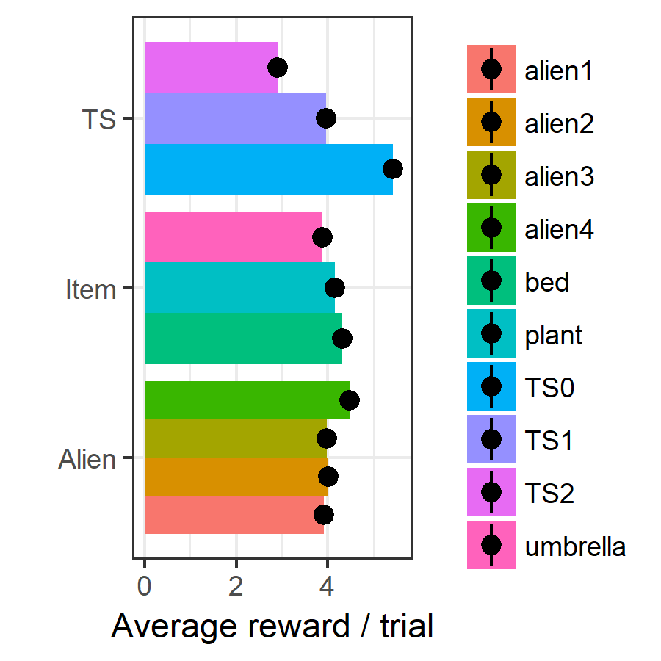



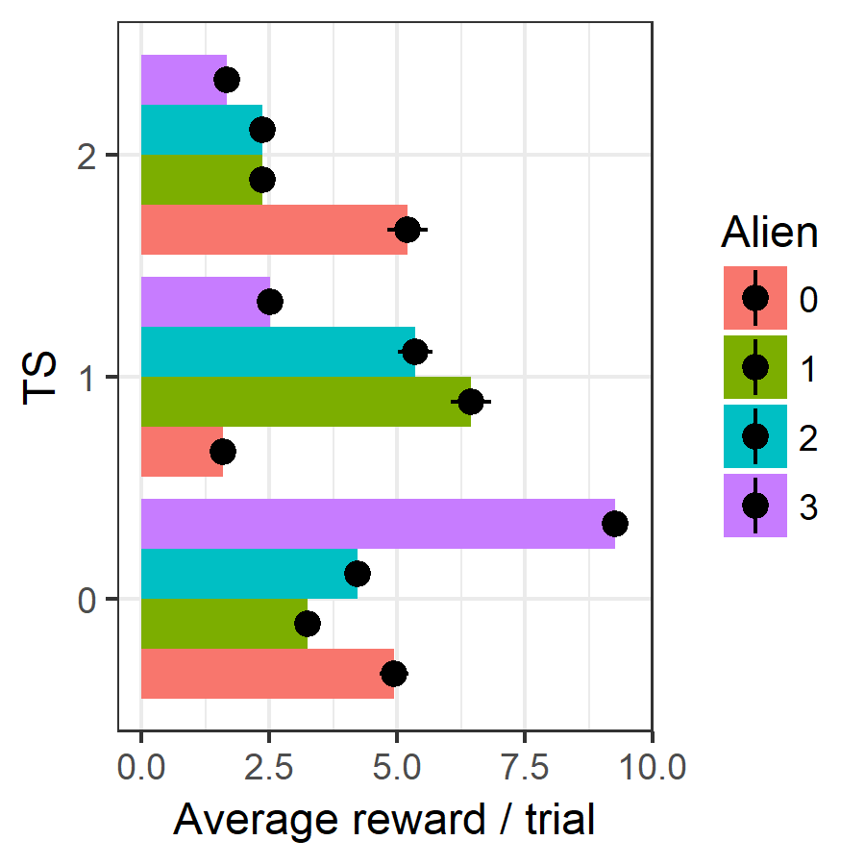
6 + 4 + 5 + 10 | 2 + 8 + 7 + 3 | 7 + 3 + 3 + 2
6.25 | 5 | 3.75
6 + 2 + 7 | 4 + 8 + 3 | 5 + 7 + 3 | 10 + 3 + 2
5 | 5 | 5 | 5
5 + 10 + 3 + 2 | 6 + 8 + 3 + 3 | 4 + 2 + 7 + 7
5 | 5 | 5

Slide 21
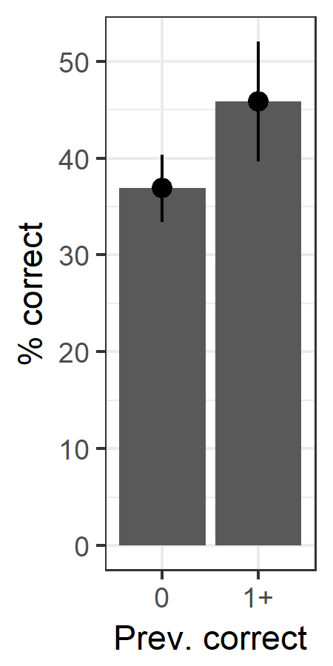
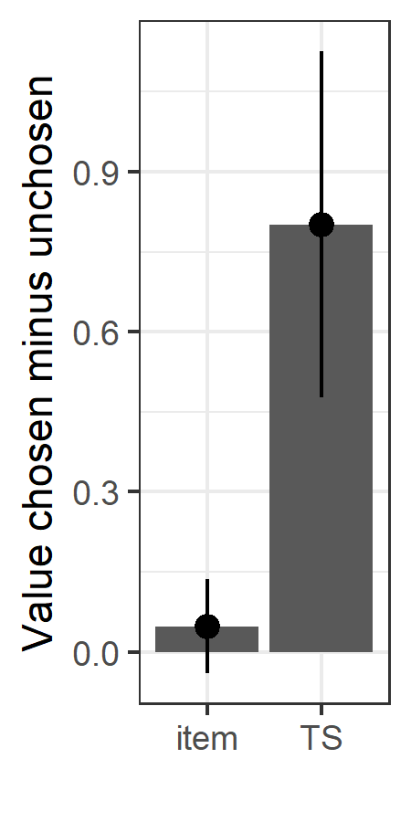
*
*
n.s.

Slide 22
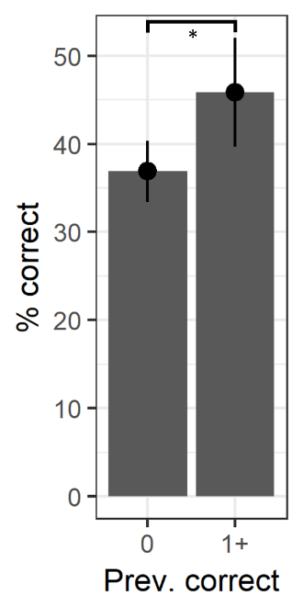
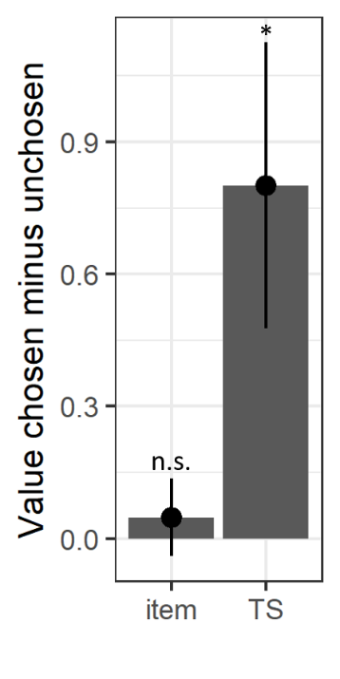
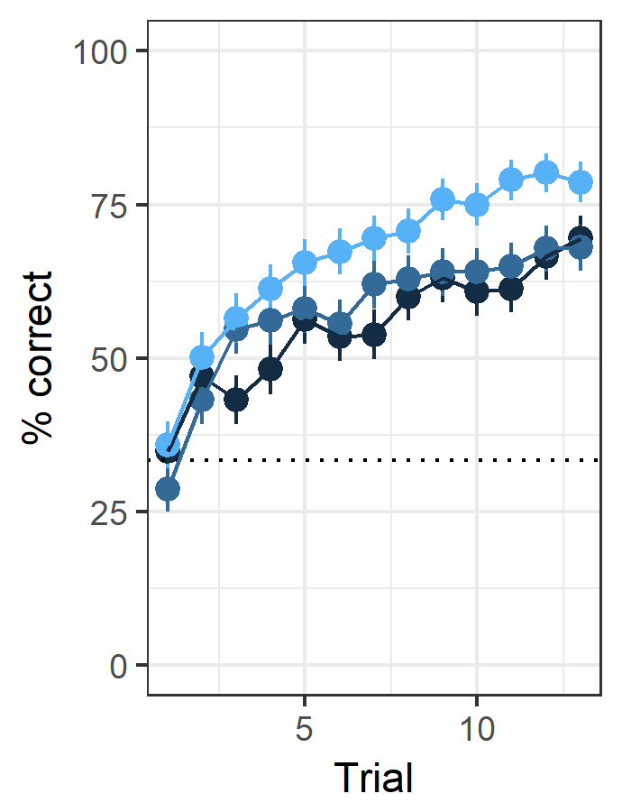
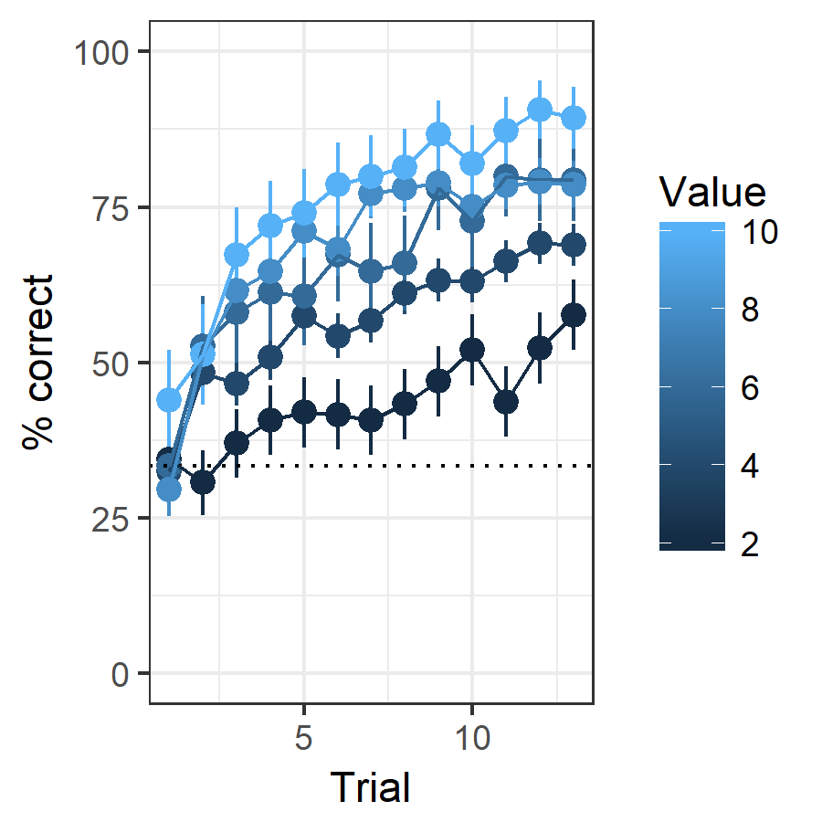
A
TS values
Stimulus values
B
C
6.25
5
3.75
10
8
6
4
2

Slide 23
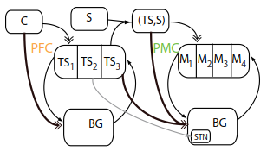

Slide 24
Context
TS
Alien
TS0
TS1
TS2
Item1
Item2
Item3
Item4
Feedback

Slide 25
Context
TS0
TS1
TS2
Select according to TS values
Stimulus
TS
Action
Action1
Action2
Action3
Select according to action values
Update TS values
Feedback
Update action values

Slide 26
Context
TS0
TS1
TS2
Select accord. to TS values
Stimulus
TS
Action
Action1
Action2
Action3
Select acc. to action values
Update TS values
Feedback
Update stimulus values

Slide 27
Context
TS0
TS1
TS2
Select according to TS values
Alien
TS
Item1
Item2
Item3
Item4
Select according to action values
Update stimulus values
Update TS values
Item
Feedback

Slide 28

Context
TS0
TS1
TS2
Select according to TS values
TS
Stimulus
Action1
Action2
Action3
Select according to action values
Action
Update TS values
Feedback
Update action values

Slide 29
Context
TS0
TS1
TS2
Select according to TS values
TS
Stimulus
Action1
Action2
Action3
Select according to action values
Action
Update TS values
Feedback
Update action values

